Slide 1
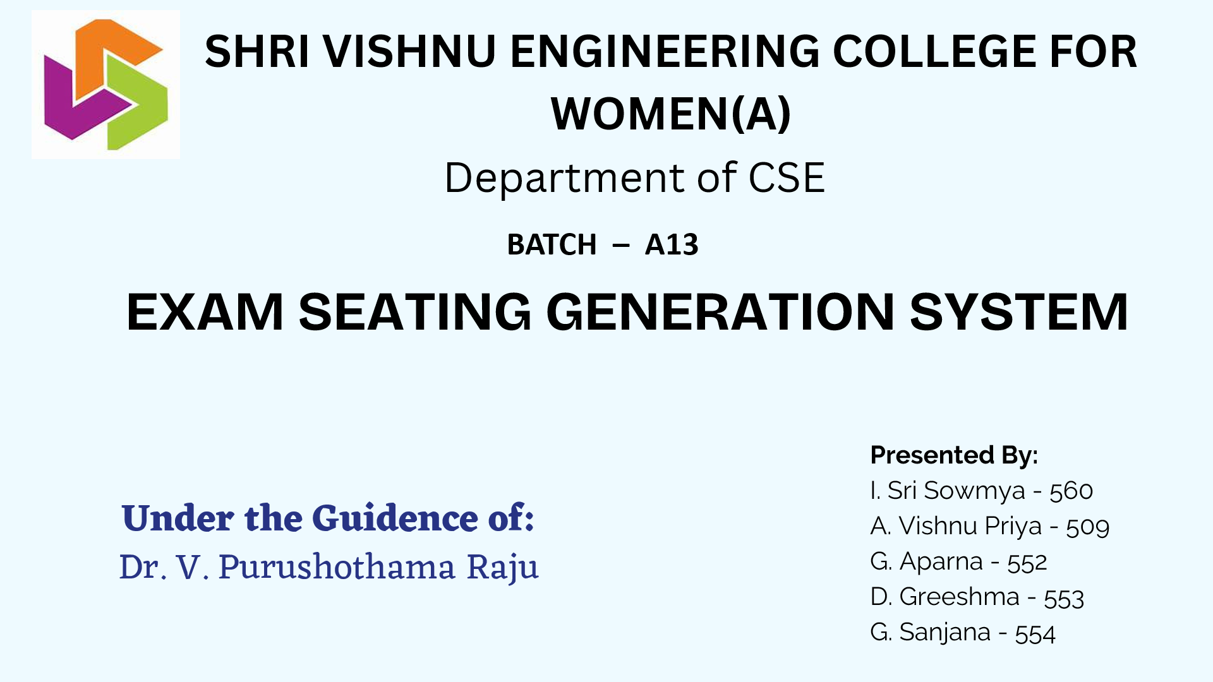
SHRI VISHNU ENGINEERING COLLEGE FOR WOMEN
Batch - A13

Slide 2

ABSTRACT
The primary objective is to automate the exam management workflow. This involves efficient seat allocation, schedule management. The system aims to eliminate manual errors, reduce time spent on administrative tasks, and enhance overall efficiency in organizing exams.
The system provides an intuitive interface for Admin, enhancing the overall exam experience. Admin functionalities include announcing updates, importing student and faculty data, assigning seats, and generating detailed reports. The system ensures a comprehensive student and faculty database.
We can extend functionalities to students and staff.

Slide 3


Slide 4


Slide 5
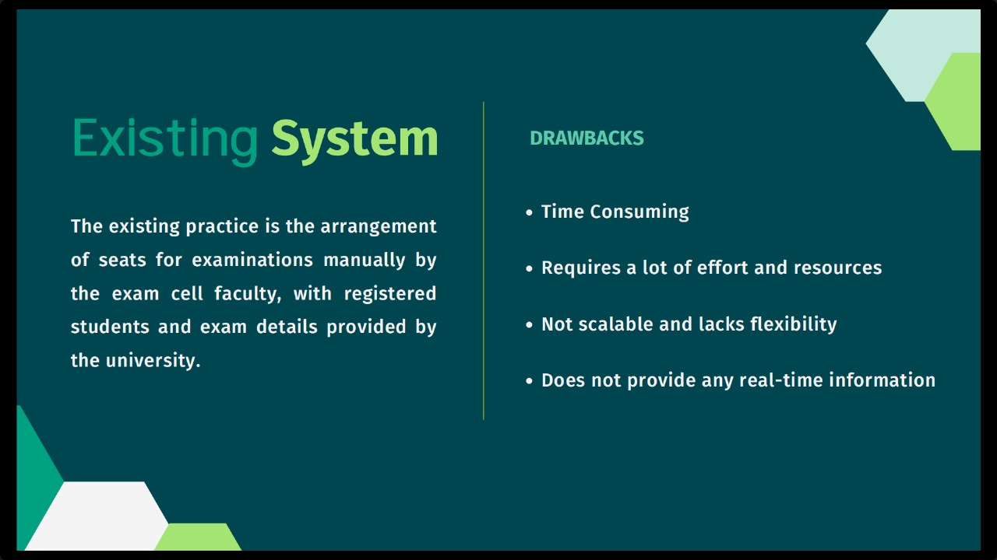

Slide 6
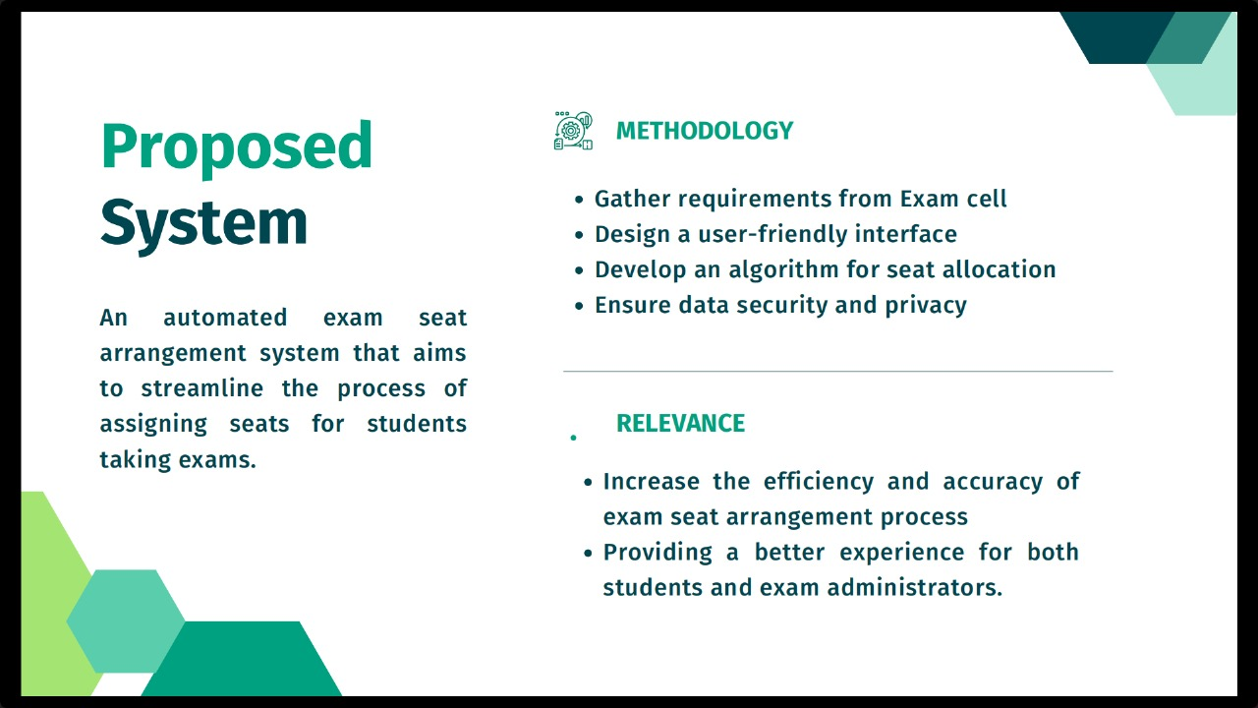

Slide 7
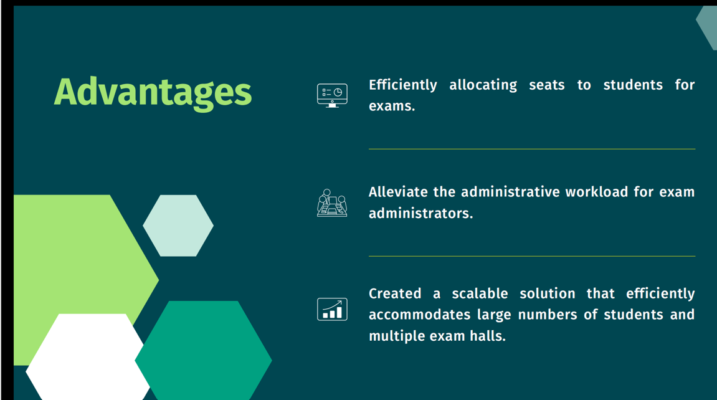

Slide 8
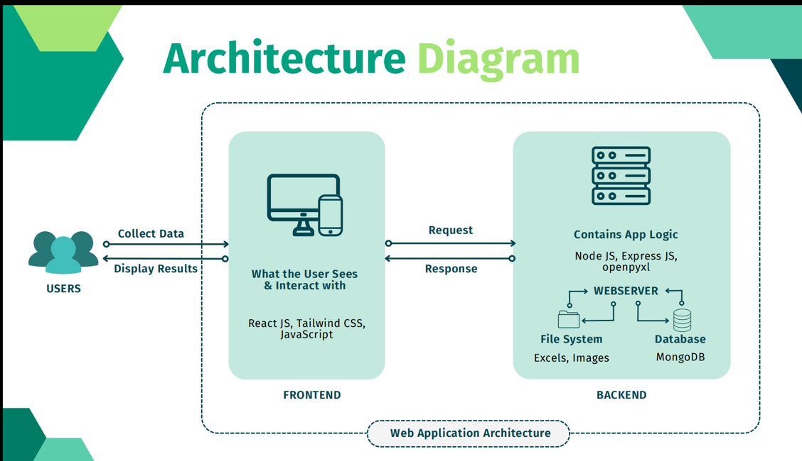

Slide 9
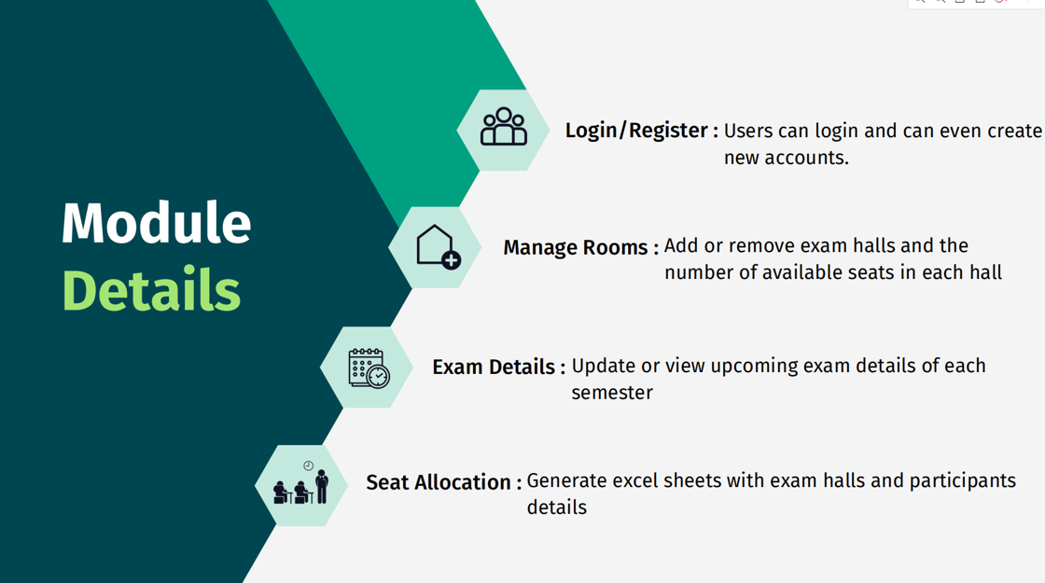

Slide 10
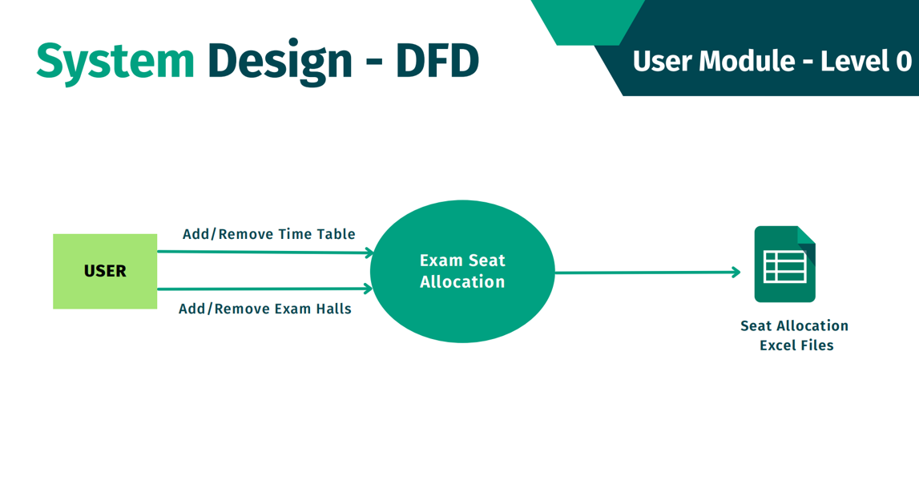

Slide 11
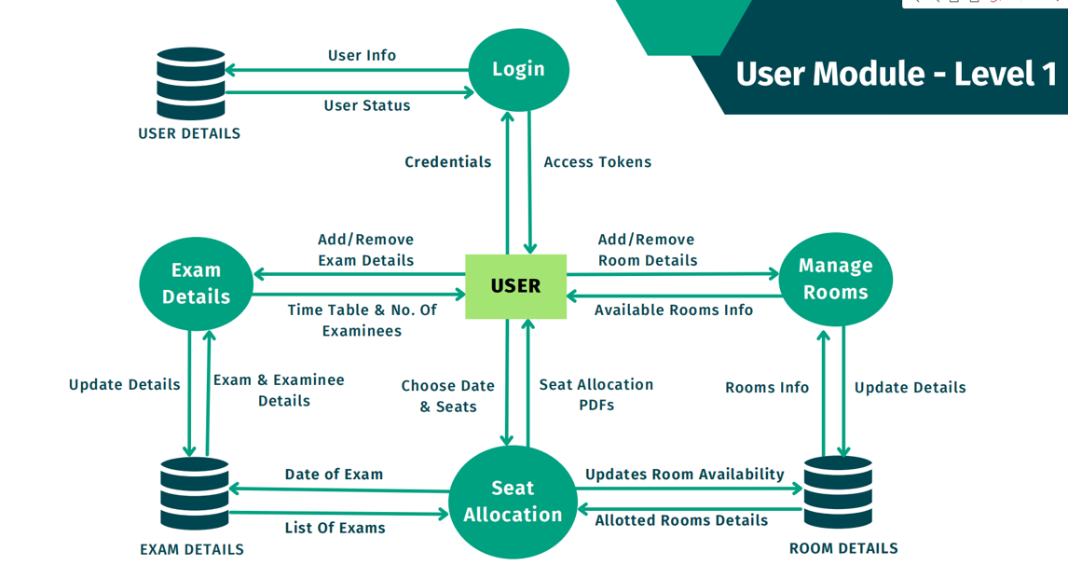

Slide 12
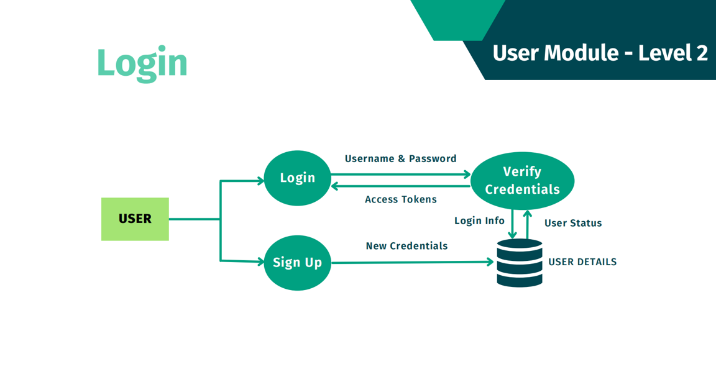

Slide 13
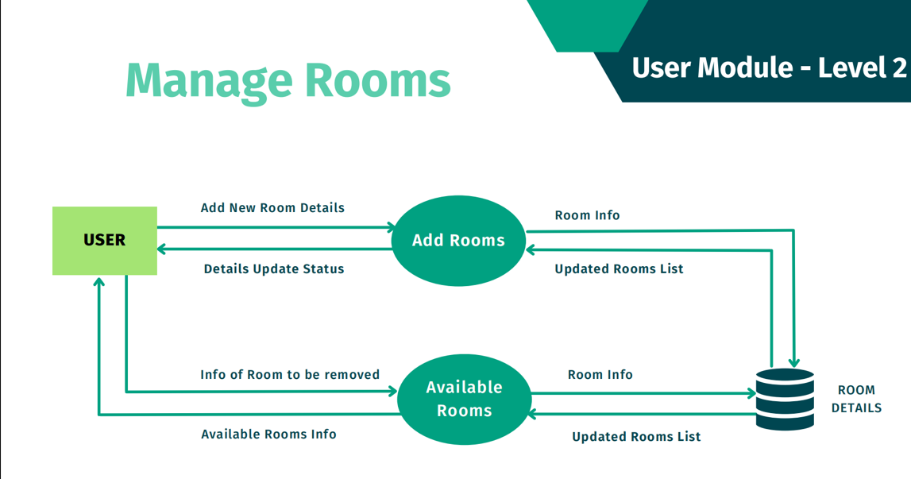

Slide 14
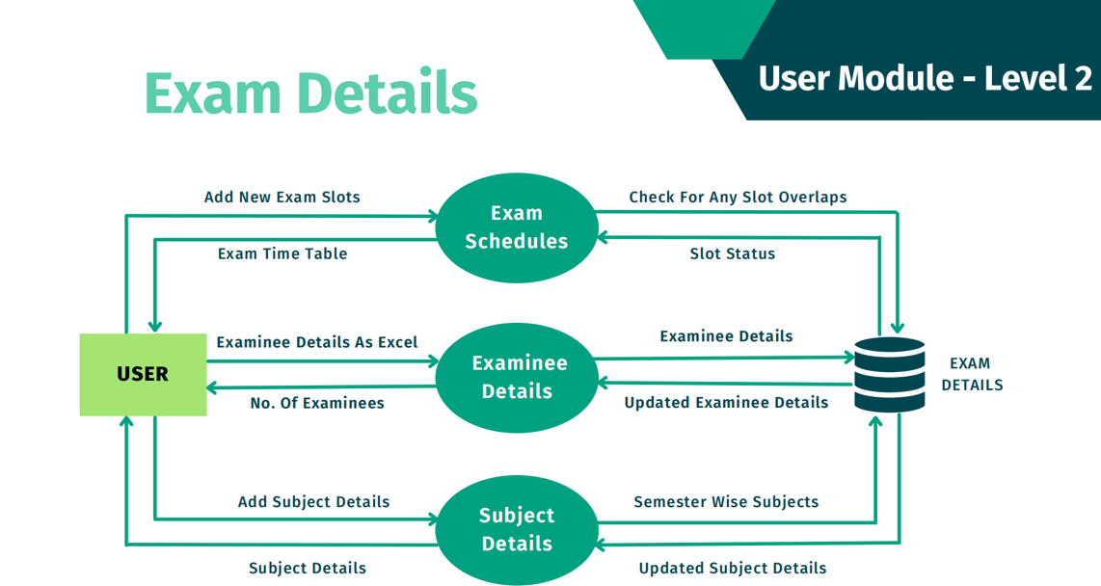

Slide 15
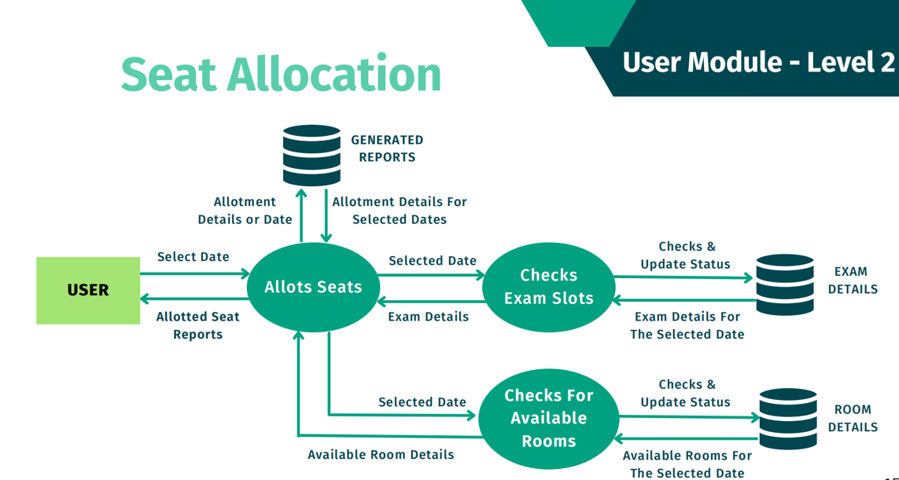

Slide 16
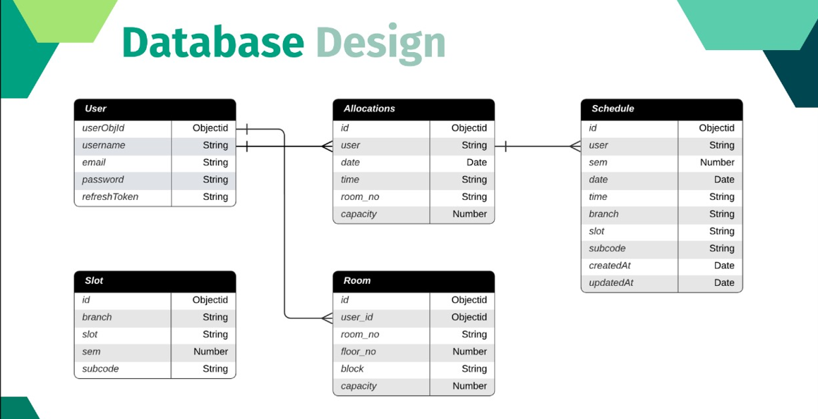

Slide 17
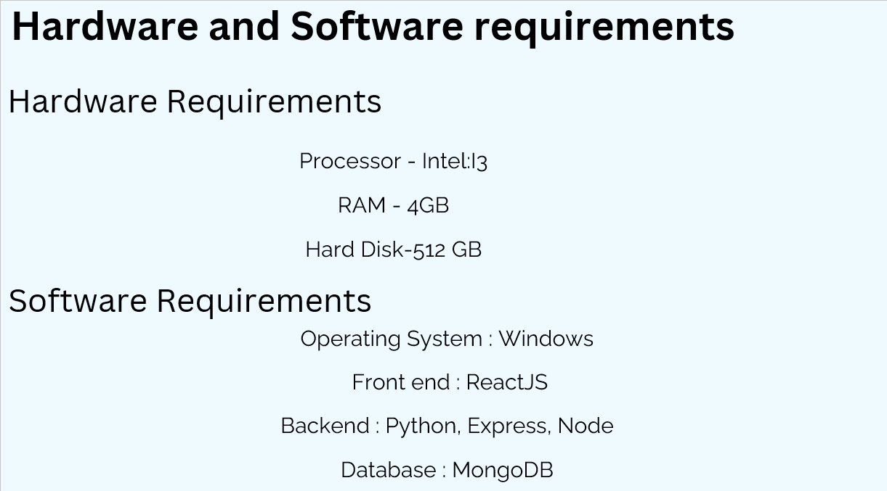

Slide 18


Slide 19


Slide 20


Slide 21
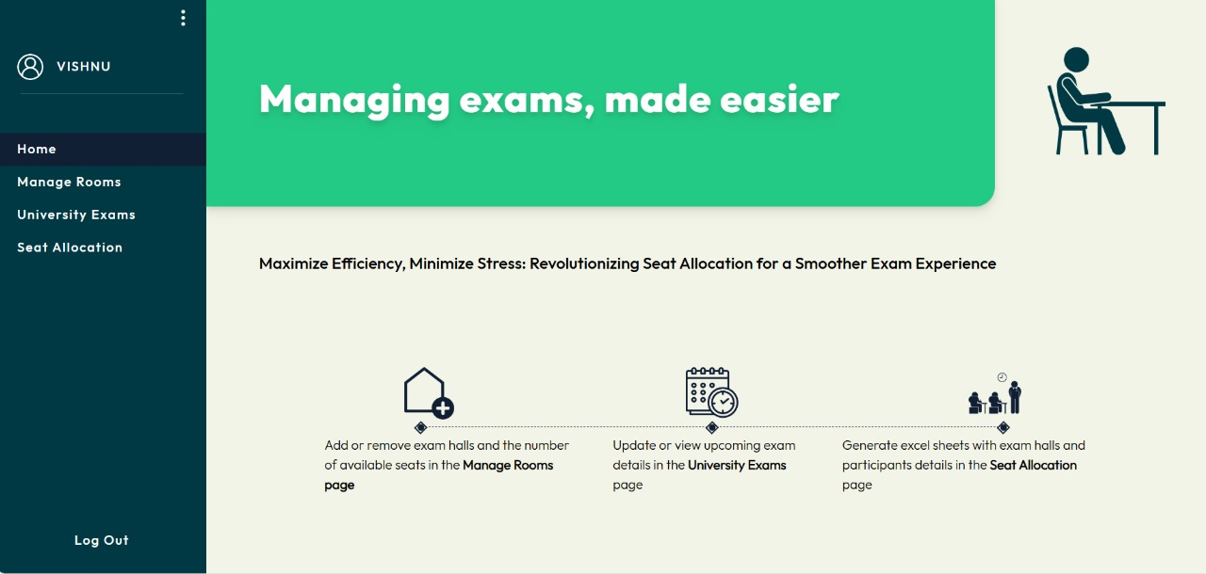

Slide 22
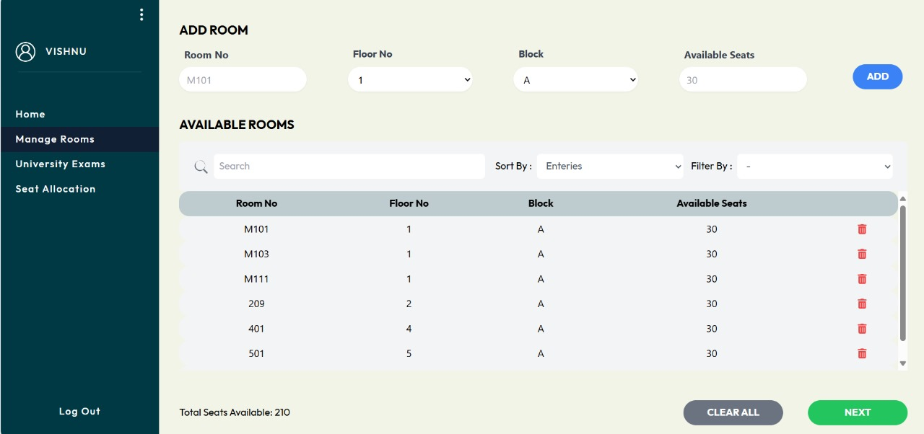

Slide 23
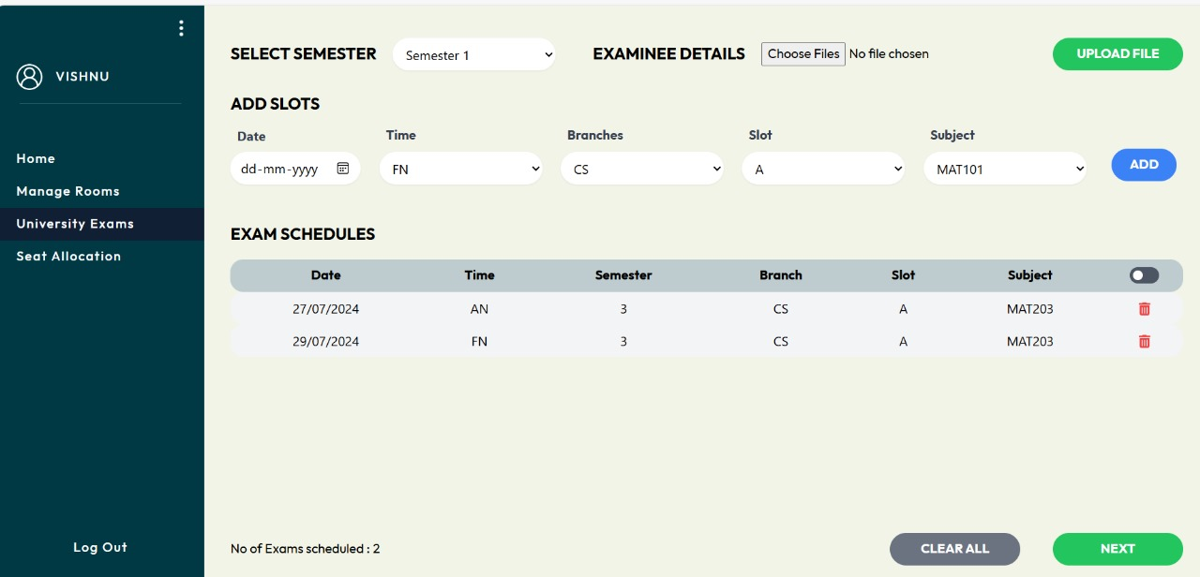

Slide 24
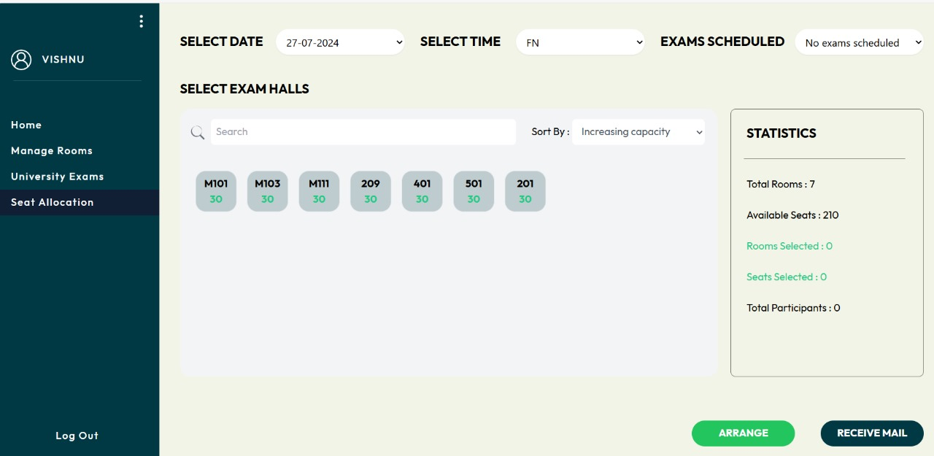

Slide 25
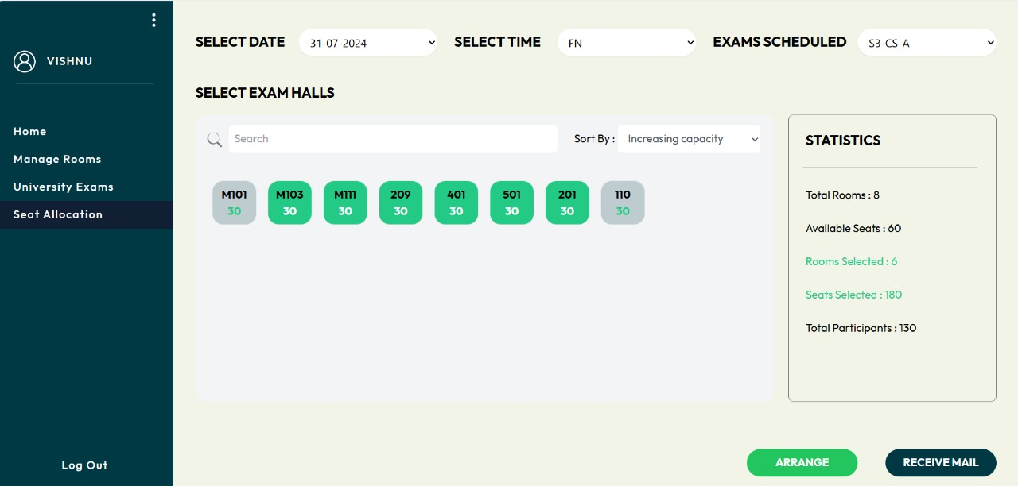

Slide 26
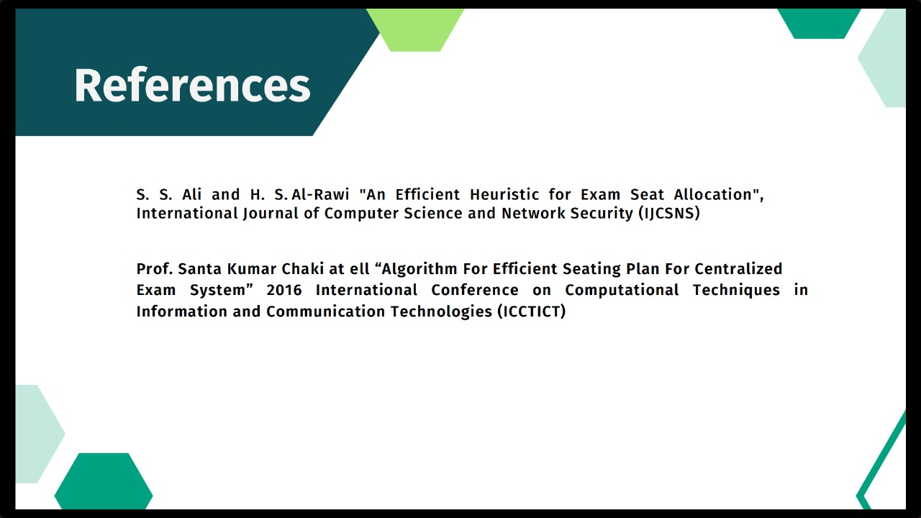

Slide 27


Slide 28
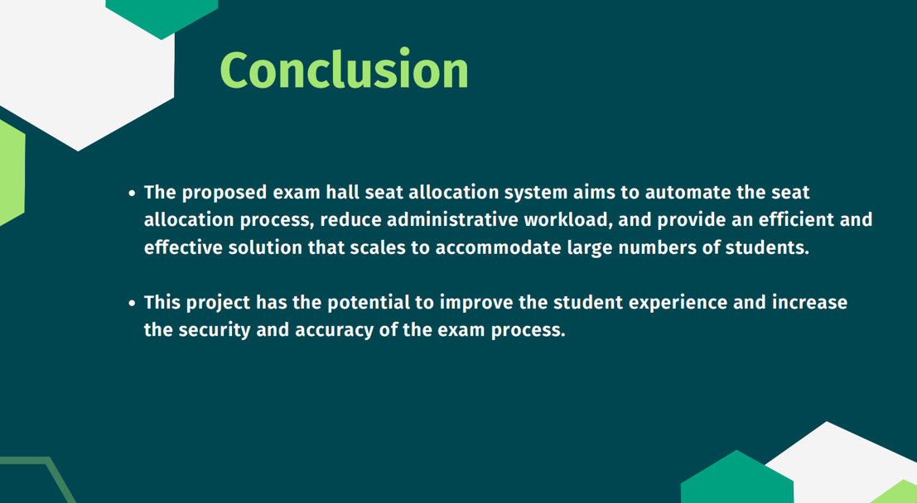

Slide 29


